Slide 1
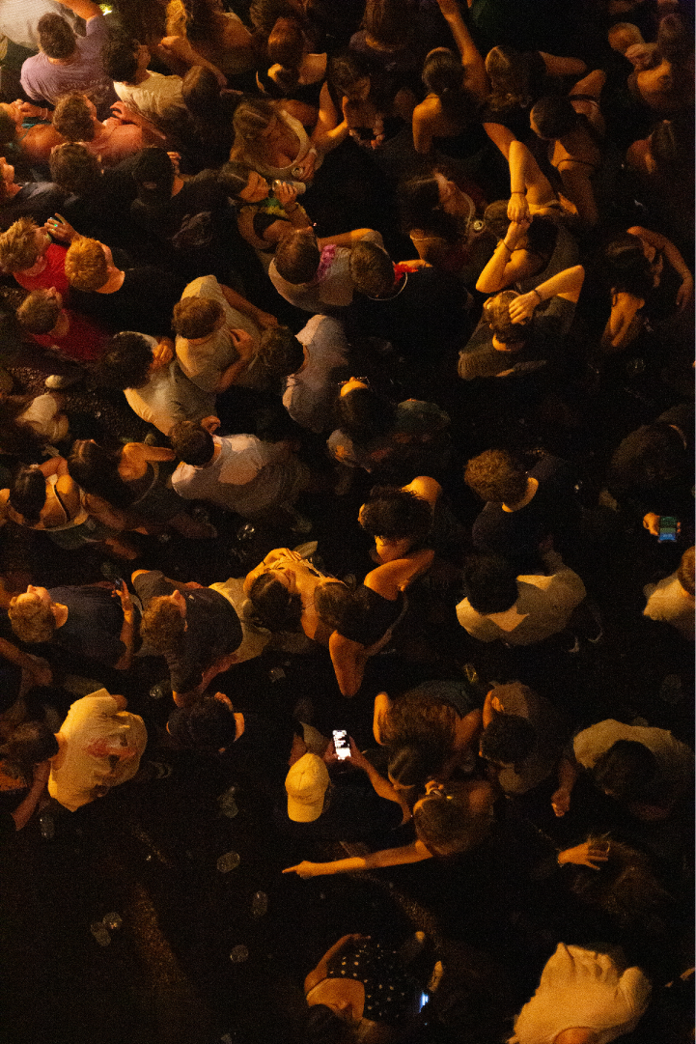
Houseshow
Connecting indie artists, indie fans,
and indie venues.

Slide 2
“Are any students interested in hosting a house show for me at their college? I want to go on tour.”
– Olive Klug on their Instagram Story

Slide 3
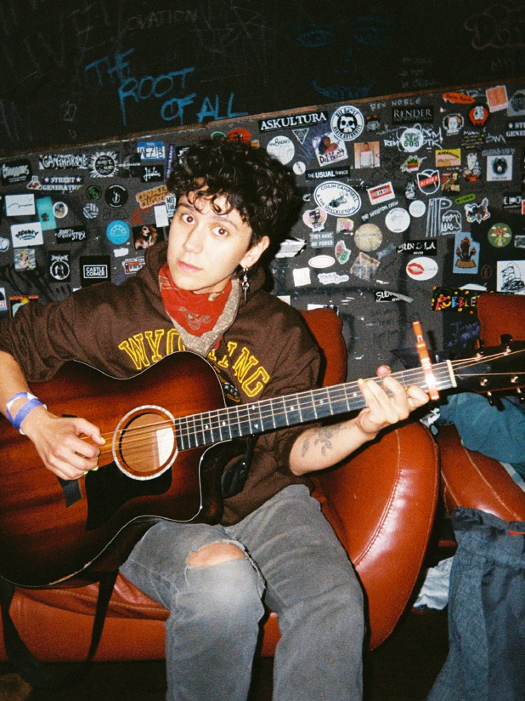
The problems for indie artists:
Robust touring is challenging for small artists
The opportunity:
Houseshow enables even the smallest artists to book venues, creating a direct connection with fans... and direct income

Slide 4
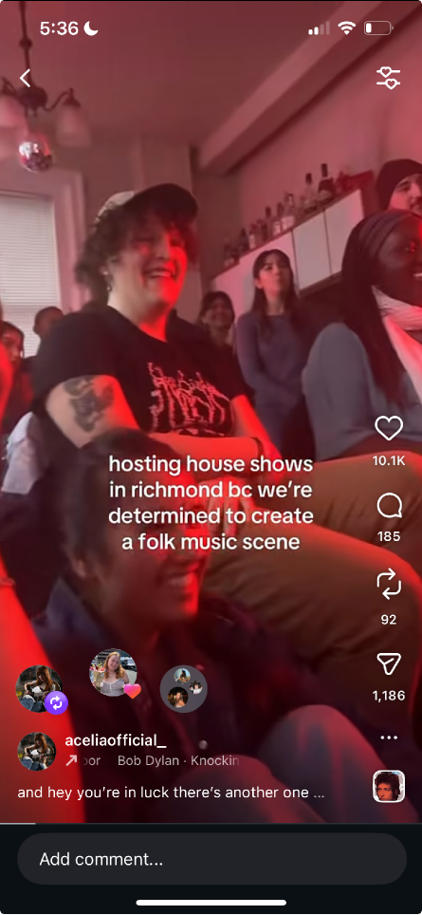

Slide 5
“Tap into this thread if you want to be notified about upcoming house shows.”
– Acelia after her Instagram Reel about house shows went viral

Slide 6
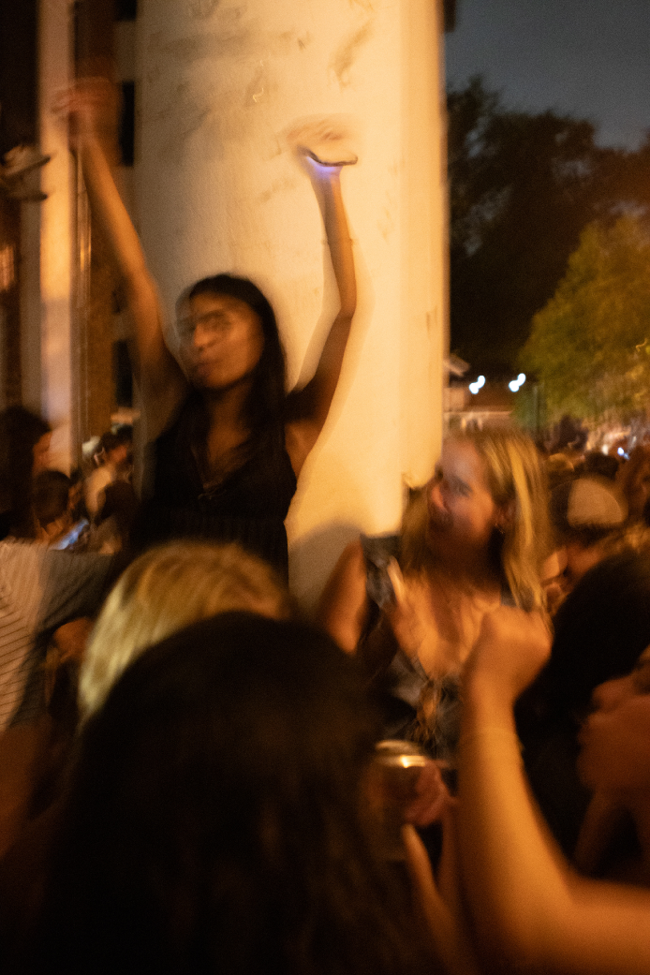
The problem for audiences:
House shows are the best way to listen to music, but they’re hard to find, their quality varies dramatically, and some cities just don’t have a house show scene
The opportunity:
Houseshow connects audiences with shows, and creates house shows where there weren’t any

Slide 7
“I want to go to more house shows this year.”
– Me

Slide 8
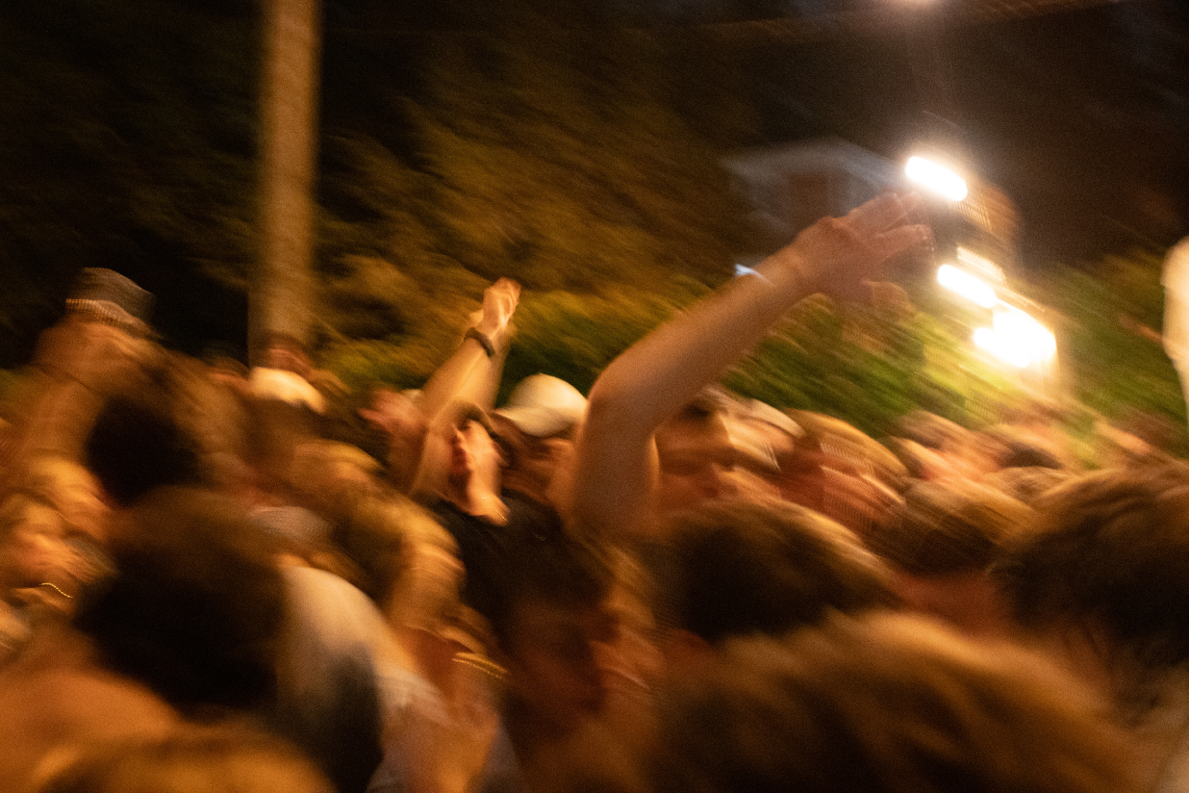

Slide 9
A. Connecting Indie Artists to Indie Hosts

Slide 10
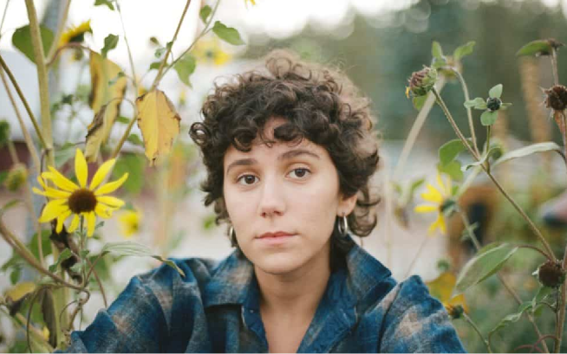



house
show
Dashboard
find venues
upcoming shows
host profile
artist profile
Search by neighborhood or university...
artist profile
find venues
upcoming shows
host profile
back to venues
back to venues
An artist makes a profile
Olive Klug
They put their names, social links, music, and vibe on their profile
They describe their band, their crowd, and their estimated ticket price
Profiles feature previous HouseShow concerts and Host reviews
Artist profiles are verified through Spotify OAuth or Verification Token
Olive Klug
queer indie folk with earnest guitar
queer indie folk with earnest guitar
from Brooklyn, NY
from Brooklyn, NY
member since June 2023
member since June 2023
4.9
(34 shows)
4.9
(34 shows)
Usually responds within 3 hours
Usually responds within 3 hours
GENRES
GENRES
Songwriter
Folk
Alternative
Songwriter
Folk
Alternative
about the artist
CONNECT
about the artist
CONNECT
@oliveklug
@oliveklug
oliveklug.com
While only a relatively short time since the van-dwelling singer-songwriter Olive Klug has fully pursued the nontraditional life of a touring musician, their sophomore album 'Lost Dog' finds them contemplating a propensity for adventure no matter what avenue of love and loss it leads down.
oliveklug.com
While only a relatively short time since the van-dwelling singer-songwriter Olive Klug has fully pursued the nontraditional life of a touring musician, their sophomore album 'Lost Dog' finds them contemplating a propensity for adventure no matter what avenue of love and loss it leads down.
Bandcamp
Bandcamp
Spotify
Spotify
book this artist
book this artist
message artist
"Hauntingly beautiful and deeply resonant"
message artist
"Hauntingly beautiful and deeply resonant"
— Brooklyn Vegan
— Brooklyn Vegan
"A must-see live experience"
"A must-see live experience"
— The FADER
— The FADER
performance details
performance details
BAND SIZE
SET LENGTH
BAND SIZE
SET LENGTH
3 members
45-60 minutes
3 members
45-60 minutes
FAN BASE
TYPICAL DRAW
FAN BASE
TYPICAL DRAW
Strong Brooklyn following, growing regional presence
30-50 people typical
Strong Brooklyn following, growing regional presence
30-50 people typical
TECHNICAL REQUIREMENTS
TECHNICAL REQUIREMENTS
Basic PA system (we can bring our own if needed)
Basic PA system (we can bring our own if needed)
3-4 power outlets for amps and pedals
3-4 power outlets for amps and pedals
Small performance area (10x10ft minimum)
Small performance area (10x10ft minimum)
Load-in access within 1 hour of show
Load-in access within 1 hour of show
WILLING TO TOUR
NEEDS SLEEPING SPACE
WILLING TO TOUR
NEEDS SLEEPING SPACE
Yes
Preferred
Yes
Preferred
upcoming tour dates
upcoming tour dates
Jan 18
Washington DC
Washington DC
Jan 18
Baltimore, MD
Jan 20
Baltimore, MD
Jan 20
Jan 22
Richmond, VA
Jan 22
Richmond, VA
Looking to fill these dates with house shows!
Looking to fill these dates with house shows!
past shows (4)
past shows (4)
Sarah's Loft
The Basement Collective
Garden Sessions
Echo Loft
Sarah's Loft
The Basement Collective
Garden Sessions
Echo Loft
Brooklyn, NY
Philadelphia, PA
Boston, MA
Providence, RI
Brooklyn, NY
Philadelphia, PA
Boston, MA
Providence, RI
Dec 2024
Nov 2024
Oct 2024
Sep 2024
Dec 2024
Nov 2024
Oct 2024
Sep 2024
host reviews
host reviews
Sarah M.
Sarah M.
Williamsburg, Brooklyn • Dec 2024
Williamsburg, Brooklyn • Dec 2024
The Violet Echoes were incredible! Professional, respectful of my space, and put on an amazing show. The crowd was completely mesmerized. They helped with setup and cleanup, and were just genuinely lovely people. Would absolutely host them again.
The Violet Echoes were incredible! Professional, respectful of my space, and put on an amazing show. The crowd was completely mesmerized. They helped with setup and cleanup, and were just genuinely lovely people. Would absolutely host them again.
David K.
David K.
Philadelphia • Nov 2024
Philadelphia • Nov 2024
One of the best house shows I've ever hosted. The band brought such positive energy and their performance was top-notch. They were also super communicative leading up to the show. 10/10 would recommend.
One of the best house shows I've ever hosted. The band brought such positive energy and their performance was top-notch. They were also super communicative leading up to the show. 10/10 would recommend.
Emma R.
Emma R.
Boston • Oct 2024
Boston • Oct 2024
Great performance and really cool people. Only small note is they ran about 15 minutes over the agreed time, but the show was so good nobody minded! Would definitely book again.
Great performance and really cool people. Only small note is they ran about 15 minutes over the agreed time, but the show was so good nobody minded! Would definitely book again.

Slide 11
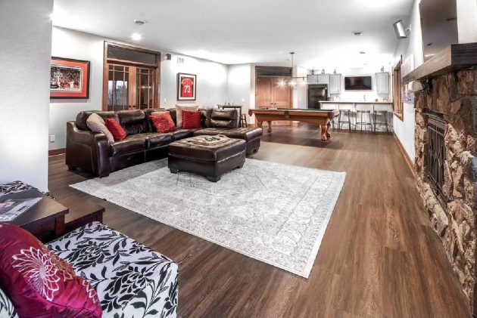



house
show
house
show
list your space
Dashboard
Search by neighborhood or university...
Search by neighborhood or university...
artist profile
find venues
upcoming shows
host profile
find venues
upcoming shows
host profile
artist profile
back to venues
A host makes a profile
back to venues
They put neighborhood, venue type, capacity, and amenities
They put images of the empty space and of previous concerts
They include whether they can provide artist lodging, and what it looks like
Profiles are verified through a video tour of the space, that must be taken in app
Like artist, host’s profiles have reviews and ratings from previous events
S
Olive Klug
Olive Klug
Sarah M.
queer indie folk with earnest guitar
queer indie folk with earnest guitar
member since March 2023
from Brooklyn, NY
from Brooklyn, NY
member since June 2023
4.8
(23 shows)
member since June 2023
4.9
(34 shows)
4.9
(34 shows)
Usually responds within 2 hours
Usually responds within 3 hours
Usually responds within 3 hours
PREFERRED GENRES
Indie Rock
Folk
GENRES
Alternative
GENRES
Dream Pop
Songwriter
Folk
Alternative
Songwriter
Folk
Alternative
CONNECT
about the artist
pitch your show
CONNECT
about the venue
@oliveklug
@oliveklug
message host
oliveklug.com
While only a relatively short time since the van-dwelling singer-songwriter Olive Klug has fully pursued the nontraditional life of a touring musician, their sophomore album 'Lost Dog' finds them contemplating a propensity for adventure no matter what avenue of love and loss it leads down.
oliveklug.com
Bandcamp
Lifelong music lover and DIY scene supporter. My loft has been hosting intimate shows for indie and folk artists for over a year. I believe in creating a welcoming space where artists can connect with fans in an authentic way. BYOB friendly, good vibes only.
Bandcamp
Spotify
Spotify
book this artist
book this artist
VENUE TYPE
CAPACITY
message artist
Spacious Loft
50 people
message artist
"Hauntingly beautiful and deeply resonant"
— Brooklyn Vegan
AVAILABILITY
LOCATION
Weekends preferred, occasional weeknights
Williamsburg, Brooklyn, NY
"A must-see live experience"
— The FADER
amenities
performance details
Built-in PA system
Stage lighting
BAND SIZE
SET LENGTH
Green room area
Full kitchen access
3 members
45-60 minutes
Street parking
Subway accessible
TYPICAL DRAW
FAN BASE
30-50 people typical
Strong Brooklyn following, growing regional presence
Artist sleeping available
Comfortable pull-out couch and air mattress available
TECHNICAL REQUIREMENTS
Basic PA system (we can bring our own if needed)
3-4 power outlets for amps and pedals
past shows (4)
Small performance area (10x10ft minimum)
Load-in access within 1 hour of show
WILLING TO TOUR
NEEDS SLEEPING SPACE
Yes
Preferred
The Violet Echoes
Whisper Valley
Silver Threads
The Morning After
Dec 2024
Nov 2024
Oct 2024
Sep 2024
upcoming tour dates
reviews
Washington DC
Jan 18
Baltimore, MD
Jan 20
The Violet Echoes
Dec 2024
Sarah was an incredible host! The space was perfect, great sound system, and the crowd was super engaged. Would love to come back.
Jan 22
Richmond, VA
Whisper Valley
Looking to fill these dates with house shows!
Nov 2024
One of the best house shows we've played. Sarah took care of everything and made us feel so welcome. The sleeping arrangements were a lifesaver!
past shows (4)
Silver Threads
Oct 2024
Great vibes and awesome crowd. Only minor issue was parking but Sarah helped coordinate that. Definitely recommend!
Sarah's Loft
The Basement Collective
Garden Sessions
Echo Loft
Brooklyn, NY
Philadelphia, PA
Boston, MA
Providence, RI
Dec 2024
Nov 2024
Oct 2024
Sep 2024
host reviews
Sarah M.
Williamsburg, Brooklyn • Dec 2024
The Violet Echoes were incredible! Professional, respectful of my space, and put on an amazing show. The crowd was completely mesmerized. They helped with setup and cleanup, and were just genuinely lovely people. Would absolutely host them again.
David K.
Philadelphia • Nov 2024
One of the best house shows I've ever hosted. The band brought such positive energy and their performance was top-notch. They were also super communicative leading up to the show. 10/10 would recommend.
Emma R.
Boston • Oct 2024
Great performance and really cool people. Only small note is they ran about 15 minutes over the agreed time, but the show was so good nobody minded! Would definitely book again.

Slide 12

house
show
list your space
Search by neighborhood or university...
find venues
upcoming shows
host profile
artist profile
back to venues
A host makes a profile
S
They put neighborhood, venue type, capacity, and amenities
They put images of the empty space and of previous concerts
They include whether they can provide artist lodging, and what it looks like
Profiles are verified through a video tour of the space, that must be taken in app
Like artist, host’s profiles have reviews and ratings from previous events
Sarah M.
member since March 2023
4.8
(23 shows)
Usually responds within 2 hours
PREFERRED GENRES
Indie Rock
Folk
Alternative
Dream Pop
pitch your show
about the venue
message host
Lifelong music lover and DIY scene supporter. My loft has been hosting intimate shows for indie and folk artists for over a year. I believe in creating a welcoming space where artists can connect with fans in an authentic way. BYOB friendly, good vibes only.
VENUE TYPE
CAPACITY
Spacious Loft
50 people
LOCATION
AVAILABILITY
Williamsburg, Brooklyn, NY
Weekends preferred, occasional weeknights
amenities
Built-in PA system
Stage lighting
Green room area
Full kitchen access
Street parking
Subway accessible
Artist sleeping available
Comfortable pull-out couch and air mattress available
past shows (4)
The Violet Echoes
Whisper Valley
Silver Threads
The Morning After
Dec 2024
Nov 2024
Oct 2024
Sep 2024
reviews
The Violet Echoes
Dec 2024
Sarah was an incredible host! The space was perfect, great sound system, and the crowd was super engaged. Would love to come back.
Whisper Valley
Nov 2024
One of the best house shows we've played. Sarah took care of everything and made us feel so welcome. The sleeping arrangements were a lifesaver!
Silver Threads
Oct 2024
Great vibes and awesome crowd. Only minor issue was parking but Sarah helped coordinate that. Definitely recommend!

Slide 13
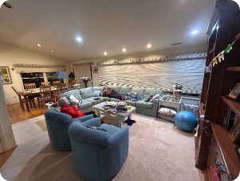
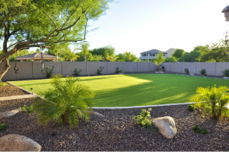
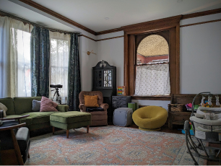
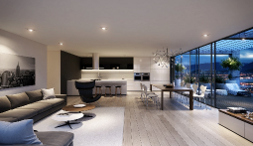
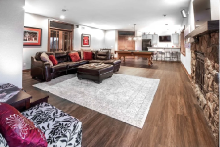
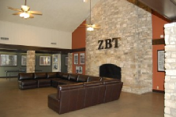
house
show
list your space
Search by neighborhood or university...
find venues
upcoming shows
host profile
artist profile
FILTERS
CITY
GENRE
MIN CAPACITY: 0
All Cities
All Genres
ARTIST SLEEP
The artist searches for hosts and pitches their show
6 VENUES
sleep available
Artist can filter venues for city, genre, capacity, and artist sleep
Pitches include the artist’s needs and vibes: the band size, the noise level, the audience type, the ticket price
Williamsburg
East Austin
Silver Lake
Brooklyn, NY
Austin, TX
Los Angeles, CA
Spacious loft with great acoustics and a built-in PA system. Perfect for intimate indie shows.
Beautiful backyard venue with string lights and covered stage area. Rain or shine setup available.
Converted garage studio with professional sound equipment and lighting. Cozy atmosphere for up to 40 guests.
50
35
40
indoor
outdoor
indoor
Indie Rock
Folk
Alternative
Country
Americana
Blues
Electronic
Experimental
Dream Pop
pitch yourself
pitch yourself
pitch yourself
sleep available
Capitol Hill
Mission District
Wicker Park
Seattle, WA
San Francisco, CA
Chicago, IL
Basement venue with a raw, authentic vibe. Great sound isolation and a welcoming DIY community.
Intimate living room space perfect for acoustic sets and stripped-down performances. BYOB friendly.
Modern loft space with high ceilings and excellent natural light during day shows. Full bar setup available.
60
30
45
indoor
indoor
indoor/outdoor
Punk
Grunge
Rock
Jazz
Soul
R&B
Hip Hop
Lo-fi
Beat Making
pitch yourself
pitch yourself
pitch yourself

Slide 14
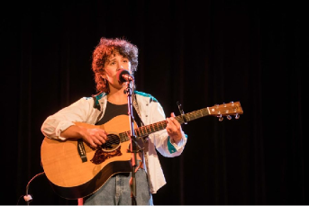
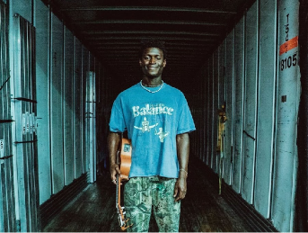
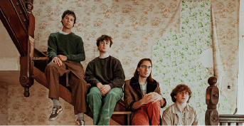
house
show
Dashboard
Search by name or genre...
find venues
find artists
upcoming shows
host profile
artist profile
FILTERS
CITY
GENRE
All Cities
All Genres
FOR HIRE
ON TOUR
NEEDS SLEEP
3.B OR a host can invite an artist
8 ARTISTS
Hosts can indicate their interest in hosting, making it easier for an artist to find hosts who are also fans
Artists can also have “hire me” badges, indicating they are interested in more traditional paid/gig work in addition to collaborative house shows
HIRE ME
Olive Klug
Monrovia Boy
Edgehill
Queer singer-songwriter core
Folk with an edge
Rock from the country
Brooklyn, NY
Austin, TX
Nashville, TN
Indie Rock
Dream Pop
Alternative
Electronic
Indie Pop
Synthwave
Bluegrass
Folk
Americana
BAND SIZE
TYPICAL DRAW
BAND SIZE
TYPICAL DRAW
BAND SIZE
TYPICAL DRAW
3
30-50
2
40-60
4
25-40
needs sleep
on tour
needs sleep
on tour
view profile
Invite
view profile
Invite
view profile
Invite
HIRE ME
4.7
4.8
(45)
(89)
Basement Theory
DJ Sunset Blvd
math rock meets midwest emo
vinyl sets • house to disco
Chicago, IL
Miami, FL
Math Rock
Emo
Post-Rock
House
Disco
Electronic
BAND SIZE
TYPICAL DRAW
BAND SIZE
TYPICAL DRAW
3
35-50
1
60-100
needs sleep
on tour
view profile
pitch show
view profile
pitch show

Slide 15
Hosts and artists use internal messaging to decide on event details: Dates, times, rules, vibes
The artist clicks
Create our event

Slide 16
house
show
list your space
Search by neighborhood or university...
← back to chat
Final event proposal
Confirm the details of your show with Sarah M. This is an agreement between the artist and the host, and is subject to any change made on or off this platform. Houseshow is not responsible for the enforcement of this agreeement.
Event Agreement
Basic details about your proposed show
Event Title
e.g., The Violet Echoes - Indie Night
Proposed Date
Start Time
Event Description
Describe the vibe, what attendees can expect, any special guests or themes...
Expected Attendance
e.g., 35
Venue capacity: 50
Set Length (minutes)
Load-in Time
e.g., 60
Technical Requirements
PA system, microphones, monitors, lighting needs, etc.
Additional Notes
Any other details the host should know (merch table, guest list, parking, etc.)
Save as Draft
Send Proposal

Slide 17
house
show
list your space
Search by neighborhood or university...
← back to chat
Final event proposal
Confirm the details of your show with Sarah M.
Financial Agreement
How this event will be monetized and promoted
Visibility on houseshow?
Link Only
Public
Private event - only people with the link can see it
Listed publicly on houseshow for discovery
Ticketing through houseshow?
Yes
No
Use houseshow's ticketing system
Handle payments independently (Venmo, cash, etc.)
Ticket Cost
$
15.00
REVENUE SPLIT PREVIEW
Enter a ticket price to see revenue split
*
Houseshow ticketing is automatically distributed 75% to artist, 15% to host, and 10% to platform at noon the day after the show
Save as Draft
Send Proposal
By clicking “Send Proposal,” you agree to the ticketing terms of the event.

Slide 18
The host reviews the details and clicks
Confirm and publish our event

Slide 19
A. Connecting Indie Artists to Indie Fans

Slide 20

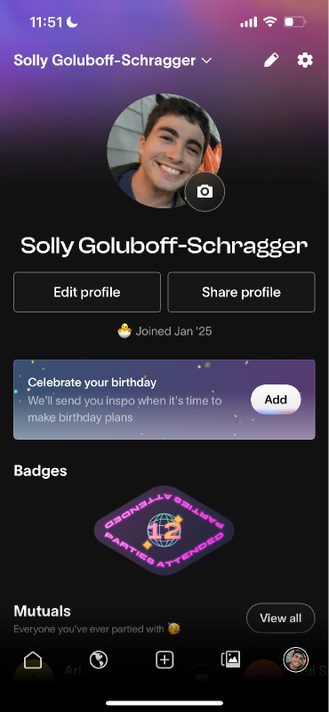
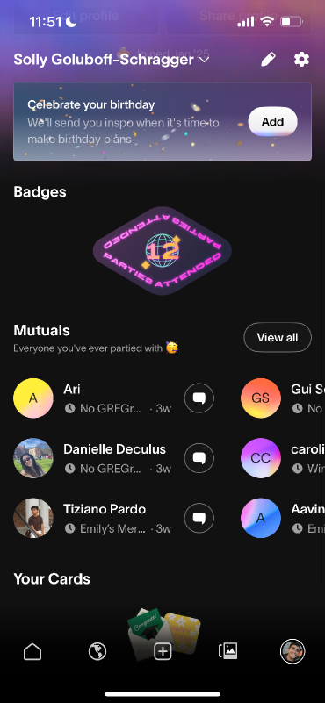
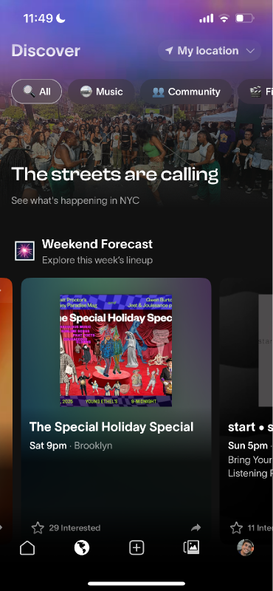
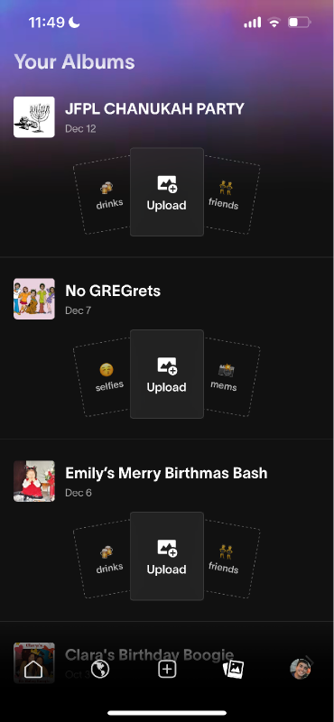
Partiful: Ticketing as a Social Platform
Profiles
Friends/Mutuals
Trending Events
Shared Photo Albums

Slide 21
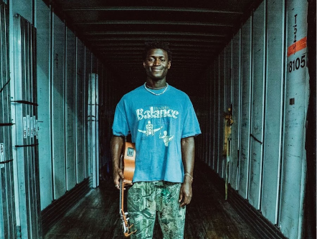

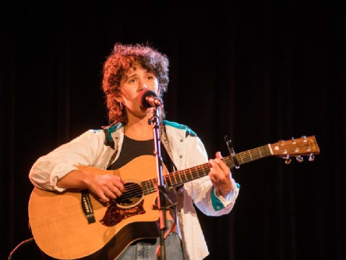


house
show
list your space
Search by neighborhood or university...
find venues
find artists
upcoming shows
host profile
artist profile
event proposal
8 UPCOMING SHOWS
only 2 left
sold out
UT Austin students only
Olive Klug
Luna Mara
Basement Frequency
Queer Singer-Songwriter with lit guitar
Intimate acoustic performance with heartfelt storytelling.
Raw, high-energy punk show. Bring earplugs and your dancing shoes.
Fri, Dec 27, 2024
8:00 PM
Sun, Dec 29, 2024
7:30 PM
Thu, Jan 2, 2025
9:00 PM
Williamsburg, Brooklyn, NY
Capitol Hill, Seattle, WA
East Austin, Austin, TX
Indie Rock
Dream Pop
Folk
Singer-Songwriter
Punk
Garage Rock
$15
50 cap
$12
35 cap
$10
60 cap
buy tickets
sold out
buy tickets
only 3 left
only 3 left
Northwestern students only
only 3 left
Neon Drift
The Crossroads Collective
Velvet Thunder
Synth-driven electronic soundscapes meet infectious pop melodies.
Smooth jazz fusion with soulful vocals and improvisation.
90s-inspired grunge with modern alternative edge.
Thu, Jan 9, 2025
8:00 PM
Sat, Jan 4, 2025
8:30 PM
Tue, Jan 7, 2025
7:00 PM
Wicker Park, Chicago, IL
Silver Lake, Los Angeles, CA
Mission District, San Francisco, CA
Alternative
Grunge
Electronic
Synth Pop
Jazz
Soul
$15
45 cap
$18
40 cap
$20
30 cap
buy tickets
buy tickets
buy tickets
BU/Berklee students only
only 4 left
Crimson Wave
Honey & Smoke
Angular guitars and driving rhythms with introspective lyrics.
Contemporary country with traditional roots and authentic storytelling.
Sat, Jan 11, 2025
9:00 PM
Tue, Jan 14, 2025
7:30 PM
Allston, Boston, MA
East Nashville, Nashville, TN
Indie Rock
Post-Punk
Americana
Country
$12
55 cap
$14
40 cap
buy tickets
buy tickets

Slide 22

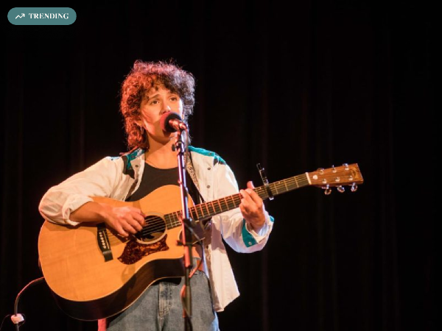
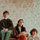



house
show
list your space
Search by neighborhood or artist...
find venues
find artists
upcoming shows
host profile
artist profile
event proposal
Your Feed
Trending Events
Shows from artists and venues you’d like
Ticketing
Sarah M.
Follow
Olive Klug
hosting in Williamsburg
Friday in Williamsburg
127 likes
•
48 going
Edgehill
Addresses are only revealed after tickets are bought
Artists and hosts get live notifications about ticket sales
Tickets are an agreement between artists and fans, not HouseShow (Like Partiful)
Saturday in East Austin
89 likes
•
52 going
Monrovia Boy
Tuesday in Silver Lake
156 likes
•
37 going
Friends Going Out
Ari B.
Going to 3 shows this week
Maya Rodriguez
Just got tickets to Neon Drift
Avery Brown
Hosting a show next Friday
Share the Vibe
127
Get Tickets • $15
3
23
Invite friends via text to shows they'd love
4 going
• 3 mutuals
Send Text Blast
Olive Klug
Queer singer-songwriter with some lit guitar
Fold
Queer
Friday, Dec 27
8:00 PM
Williamsburg, Brooklyn, NY
48/50 tickets sold
Jake R.
Follow
hosting in East Austin
TRENDING
89
2
15
Get Tickets • $10
3 going
• 2 mutuals
Basement Frequency
Raw, high-energy punk show. Bring earplugs and your dancing shoes.
Punk
Garage Rock
Thursday, Jan 2
9:00 PM
East Austin, Austin, TX
52/60 tickets sold
Maya L.
Follow
hosting in Silver Lake
TRENDING
156
3
42
Get Tickets • $18
2 going
• 2 mutuals
Neon Drift
Synth-driven electronic soundscapes meet infectious pop melodies.
Electronic
Synth Pop
Saturday, Jan 4
8:30 PM
Silver Lake, Los Angeles, CA
37/40 tickets sold
Photos from past shows

Slide 23



The hosting of airbnb
The booking of Live Nation
The social of Partiful

Slide 24

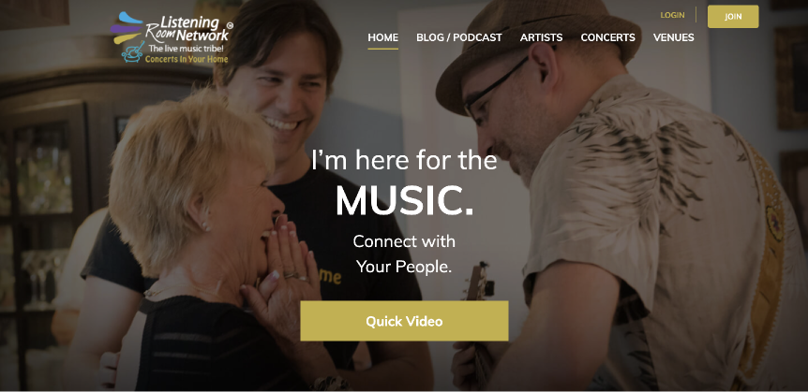
Listening Room Network
Sofar

Slide 25
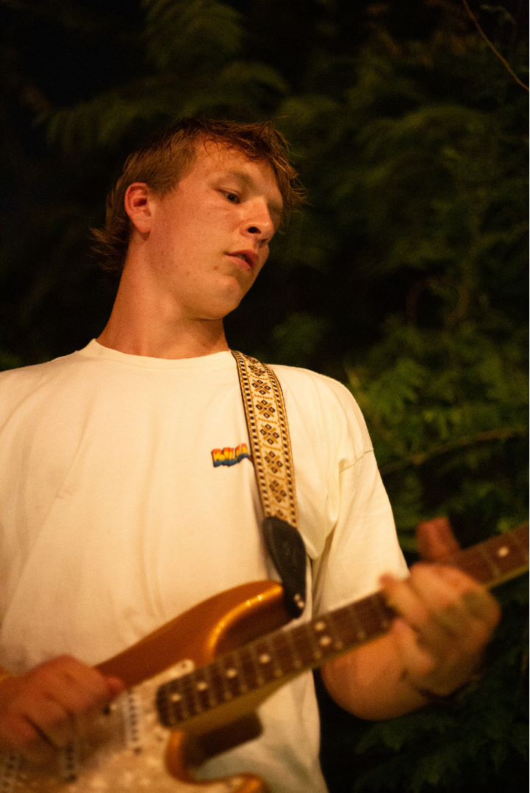
Where to start: College Campuses
College campuses have a high concentration of young people looking for fun events
Students on college campuses are already used to random people being in their houses, and they usually live in places where they can make a lot of noise
Ticketing can be restricted to specific universities
College campuses will be useful incubators for the social angle — just like the collegiate popularity of Partiful

Slide 26
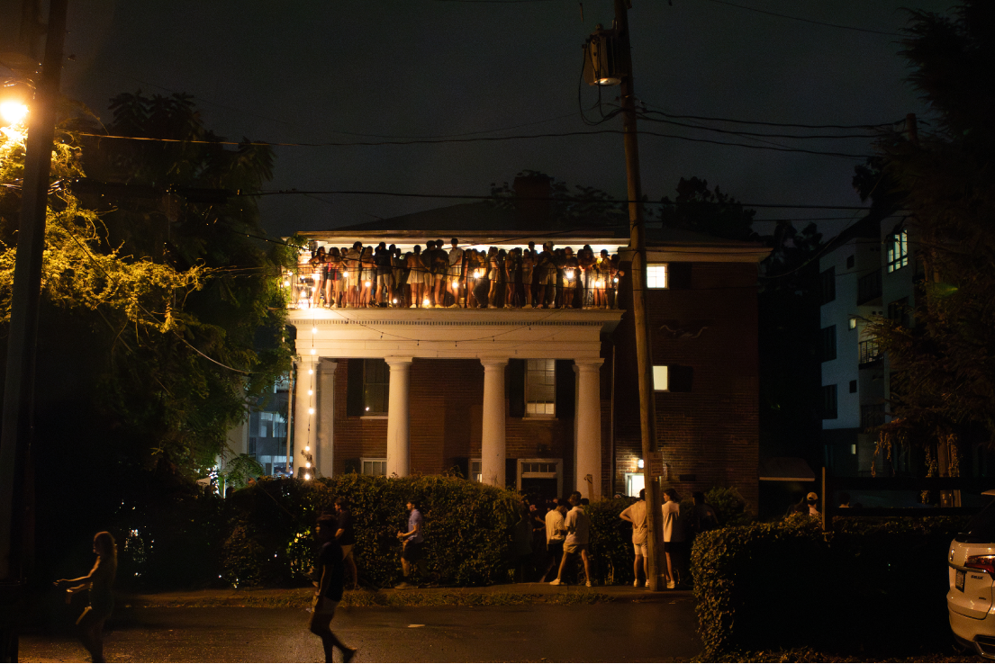
Where to start: UVA
Start with a place like UVA, recruit some houses, recruit some student bands, recruit some outside artists
Begin by booking artists manually, but using the software of the website to set up the concert
Have student ambassadors connect with frats and indie clubs to host bands
Promote it heavy + build a foundation of contact information
Start to get some organic use
Grow

Slide 27
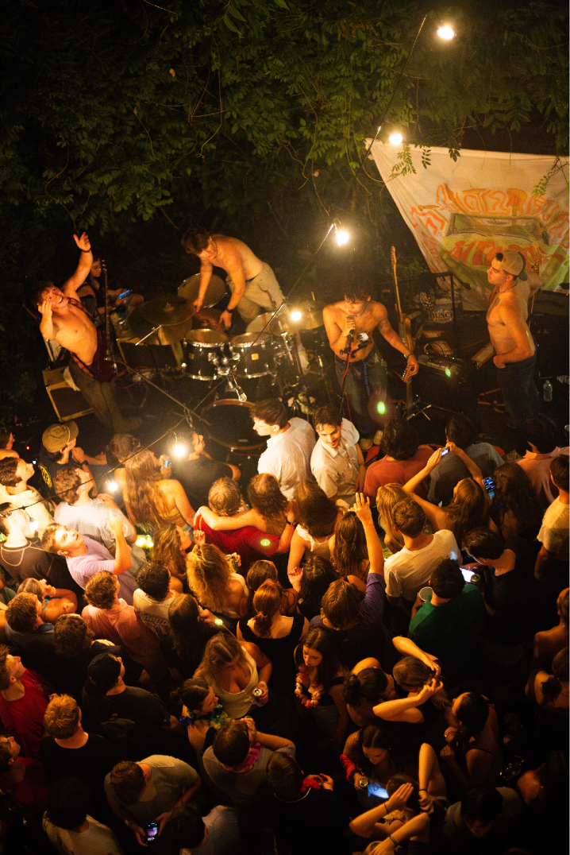
Scaling Up
Growing past college campuses to other audiences
Start to incorporate small indie venues onto the platform (They do not have to book through the platform, but they can promote)
Going beyond music: Poetry readings, book talks, standup comedy, art showings, film festivals, DJ sets, plays, and more
Start recording house shows as live sessions

Slide 28
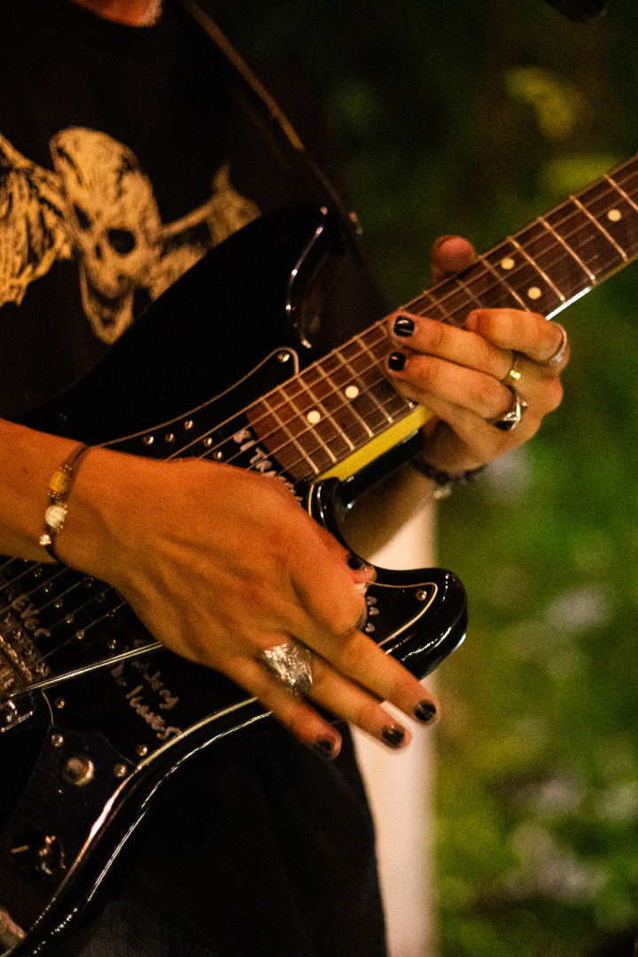
The Money
Primary Source: A 10% cut from every ticket sale
Potential other sources:
Tiered subscriptions for users, giving paid members exclusive access to shows and playing opportunities
Recording live sessions - revenue from YouTube and other media platforms
Original Curated Events by HouseShow

Slide 29
Building it
Organic booking and ticketing
Expansion
Recruit and [hand] book artists and hosts
Use college campuses as incubators
Adoption
Liability (Legal)
Digital Interface
Incorporation
Infrastructure

Slide 30


(Where we need funding)
Liability (Legal)
Digital Interface
Incorporation
Infrastructure

Slide 31
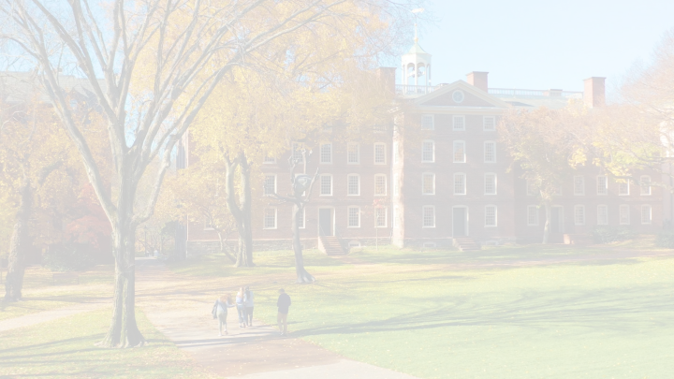
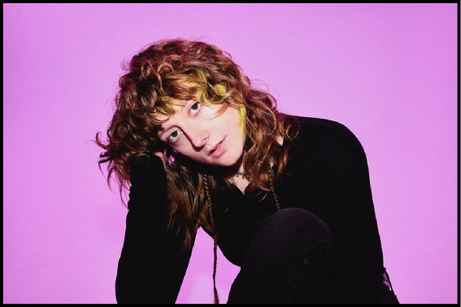

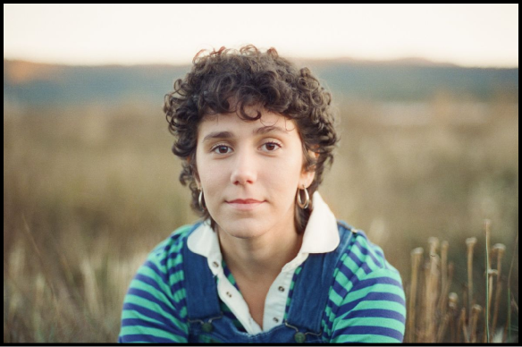
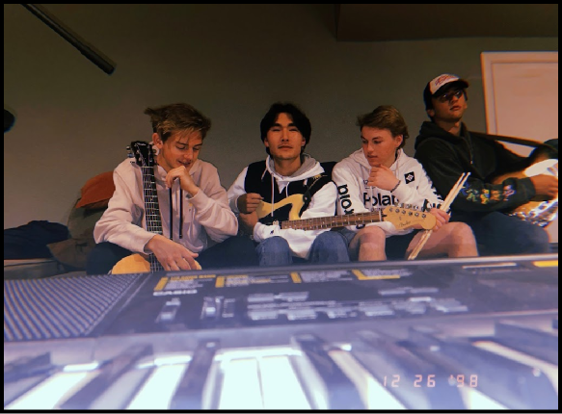
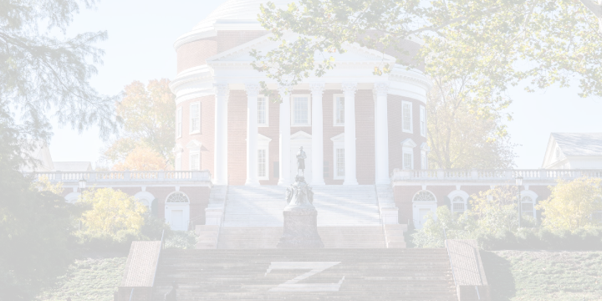

My expertise

Slide 32
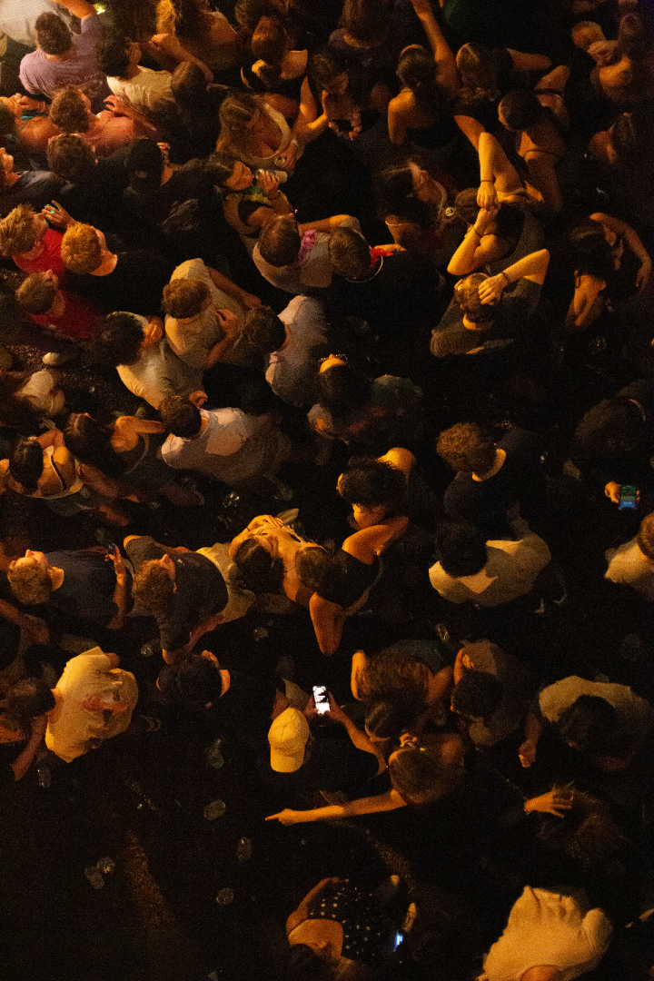
Houseshow
Connecting indie artists, indie fans,
and indie venues.

